Slide 1
IPL Match Outcome Prediction using Machine Learning
Meganathan

Slide 2
Introduction
• Problem: Predicting IPL match outcomes using ML.
• Dataset: IPL matches dataset with teams, toss, and results.
• Objective: Identify best ML model for match prediction.

Slide 3
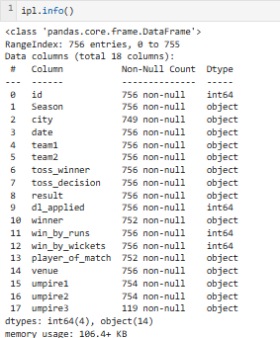
Data Understanding
Dataset includes match details like teams, toss, winner, etc.
Columns: Team names, toss decision, match winner, etc.
Sample data reviewed to understand structure.

Slide 4
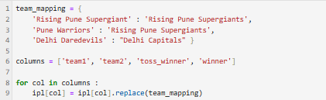
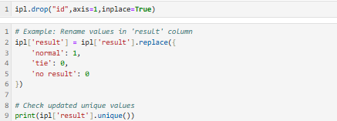
Data Cleaning
Handled missing/null values.
Converted categorical features using encoding.
Removed outliers and inconsistencies.

Slide 5
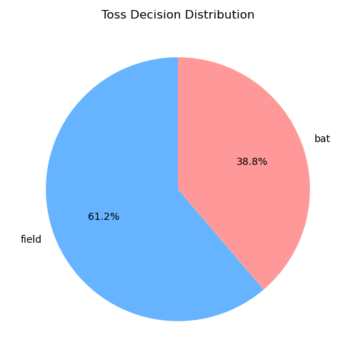
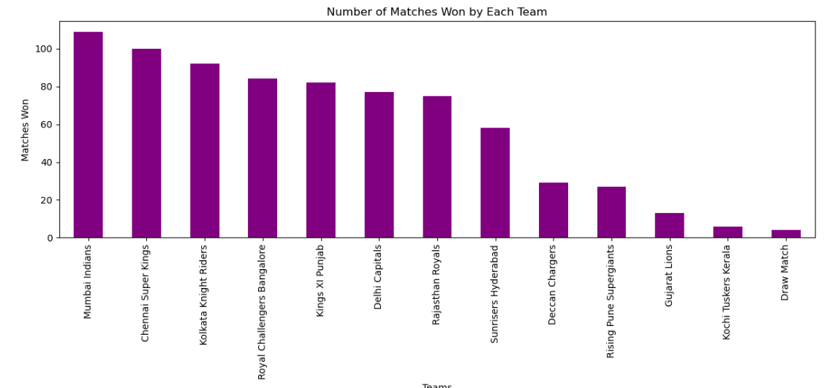
Exploratory Data Analysis (EDA)
• Visualized team performance and toss outcomes.
• Explored correlations between features and winners.
• Key insights guided preprocessing and feature selection.

Slide 6
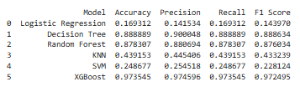
Modeling Process
Models: Logistic Regression, SVM, KNN, Decision Trees, Random Forest, XGBoost.
Hyperparameter tuning: Grid Search & Random Search.
Metrics: Accuracy, Precision, Recall, F1 Score.

Slide 7
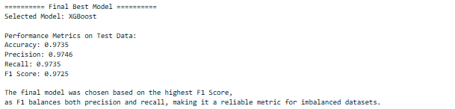
Model Comparison
Compared performance of all models.
Ensemble models (Random Forest, XGBoost) performed best.
Final Model: XGBoost after hyperparameter tuning.

Slide 8
Conclusion & Future Work
• XGBoost provided the best overall performance.
• Future work: retrain with updated IPL data for improved accuracy.

Slide 9
THANK YOU

